Slide 1

Rockbuster Stealth LLC
Allison Weese
June 26th, 2024

Slide 2
Project Overview
Rockbuster Stealth LLC has long dominated the rental business with physical stores around the globe.
In response to the uptick in streaming services, the Rockbuster Stealth management team is trying to leverage their current potential by launching an online streaming platform.

Slide 3
Key Questions
Which films contributed to the revenue the most, and the least.
What is the average rental duration for our films?
Which countries contain the highest concentration of our customers?
Where are our high-value customers located?
Do sales vary between geographic regions?

Slide 4
Data Overview
Rental Duration (in days)
Minimum: 3
Maximum: 7
Average: 4.985
Replacement Cost (in dollars)
Minimum: $9.99
Maximum: $29.99
Average: $19.98
Ratings (in number of films)
PG-13: 223
NC-17: 210
R: 195
PG: 194
G: 178
Movie Length (in minutes)
Minimum: 46
Maximum: 185
Average: 115.272
Movie Length (in minutes)
Minimum: 46
Maximum: 185
Average: 115.272

Slide 5
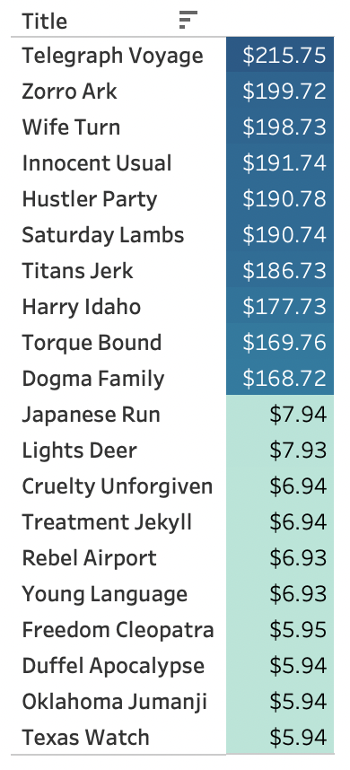
Film Popularity
In the darker blue color at the top, we have the films that have brought in the most revenue. At the bottom of the list in the lighter teal color are the 10 films that brought in the least revenue.

Slide 6
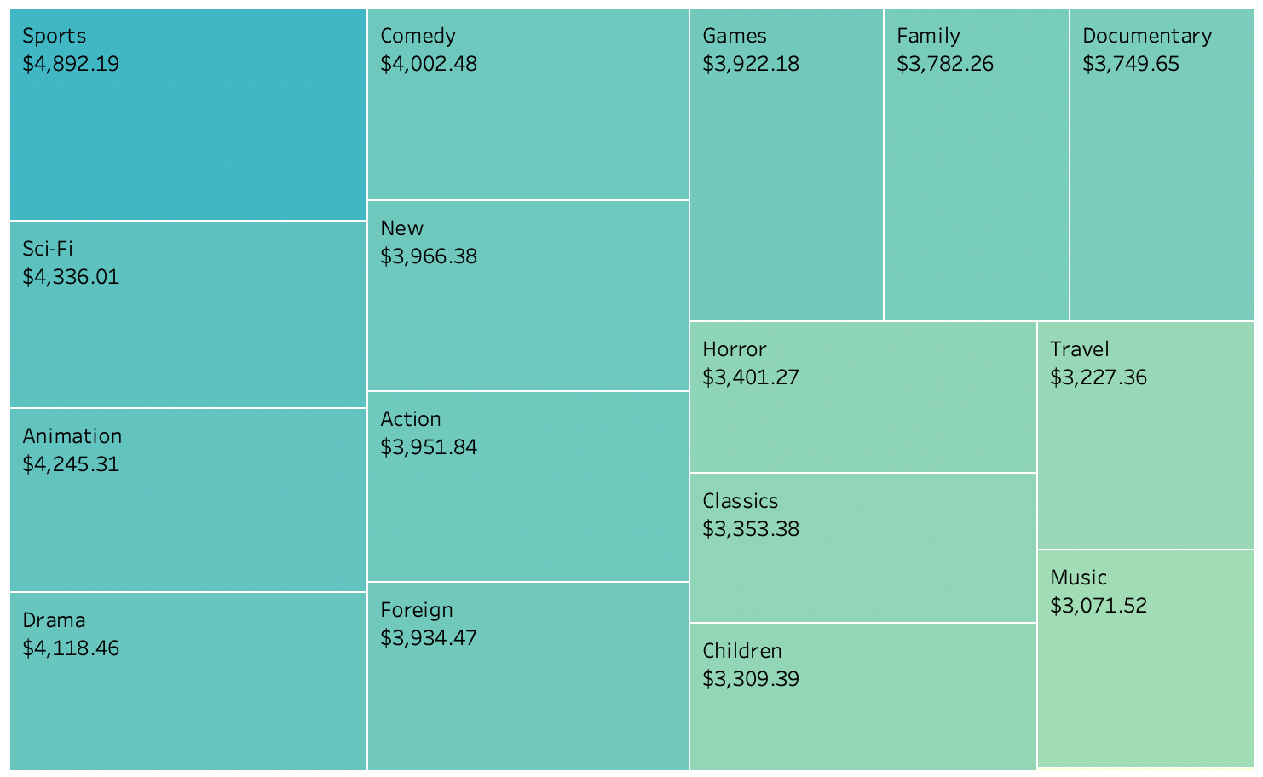
Genre Popularity
This shows each genre of film we offer and how much revenue each respective film has brought in. Thriller is the only genre not in this visualization due to only bringing in $47.89

Slide 7
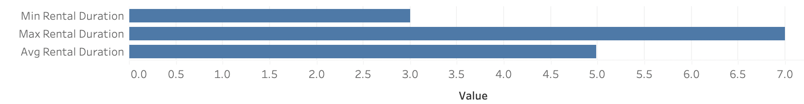
Rental Duration (IN DAYS)
This is something to consider when implementing a rental window for the new streaming platform

Slide 8
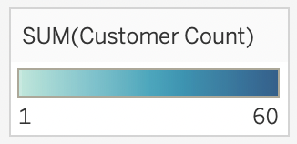
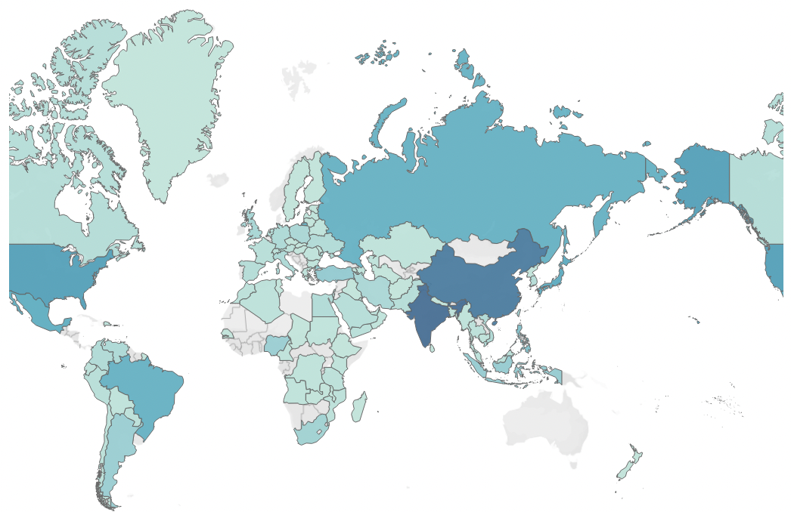
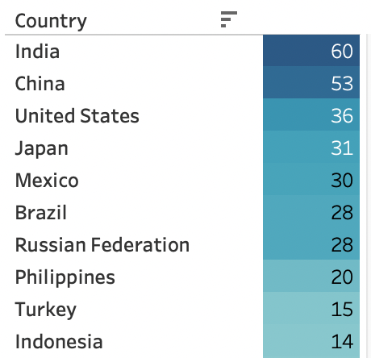
Where in the World Are Our Customers?
Top 10 Countries by Customer Count

Slide 9
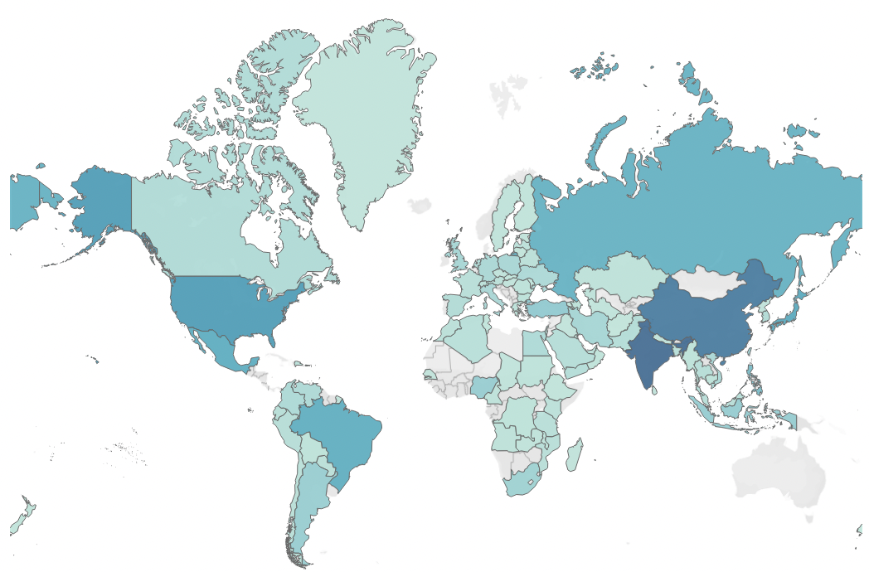
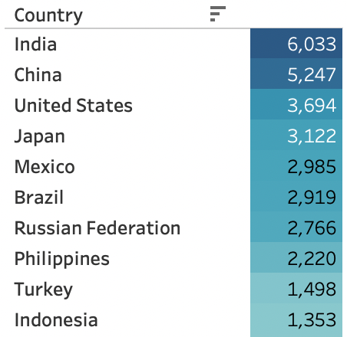
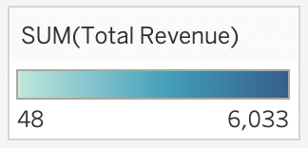
Where do they spend the most?
Top 10 Countries By Spending

Slide 10
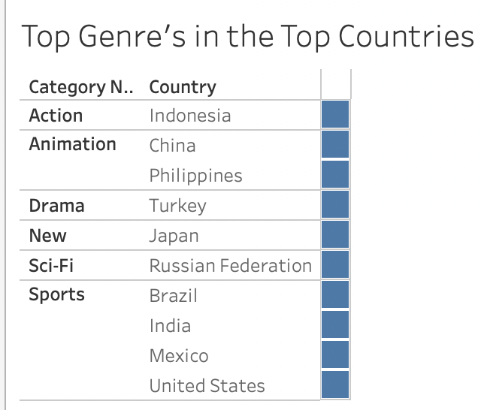
Marketing
Knowing which film genre’s do the best (based on revenue) in these 10 countries helps the marketing team to know which genre’s to spend more time marketing in these countries. For example, Animated movies do better in China and the Philippines. It would be wise to spend more time and money advertising animated films in those countries.

Slide 11
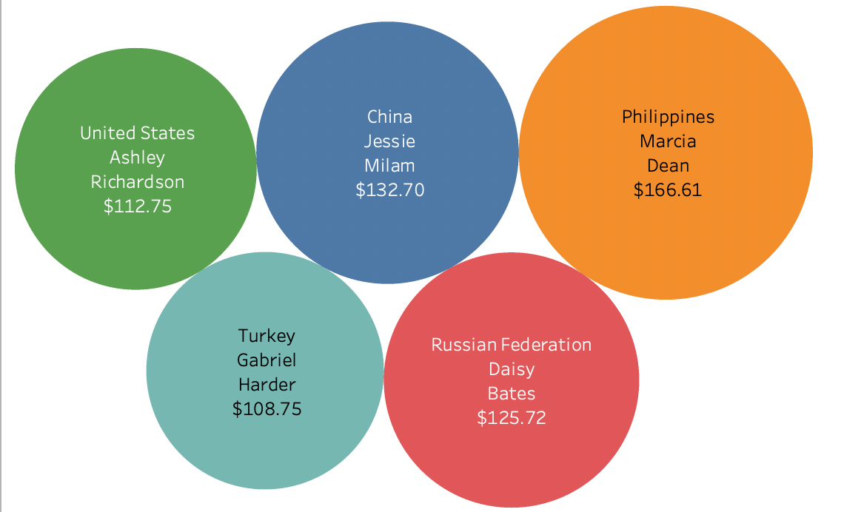
High Value Customers!
These are our top 5 highest valued customers due to their spending habits as well as which country they are from. Included is how much money they spent at Rockbuster Stealth in a year.

Slide 12

Recommendations
Promote movies that bring in the highest revenue. Pricing could also be set based on popularity.
Advertise the most popular genres, like Sports, Sci-Fi, and Animation.
Focus implementation of the streaming platform in high-revenue areas such as India, China, and the USA.
Implement a rewards program that keeps customers coming back and rewards them for spending money with Rockbuster Stealth LLC.

Slide 13

Thank you for your time, and Please contact me with any questions @: Allisonweese95@gmail.com

Slide 14
Tableau Links
https://public.tableau.com/app/profile/allison.weese/viz/HighestLowestGrossingFIlms/Sheet1
https://public.tableau.com/app/profile/allison.weese/viz/RockbusterHighestGrossingGenres/Sheet1
https://public.tableau.com/app/profile/allison.weese/viz/Rockbusterrentalduration/Sheet1
https://public.tableau.com/app/profile/allison.weese/viz/topcountriesbycustcnt/Sheet1
https://public.tableau.com/app/profile/allison.weese/viz/topcountriesbycustcntmap/Sheet1
https://public.tableau.com/app/profile/allison.weese/viz/revmap/Sheet1
https://public.tableau.com/app/profile/allison.weese/viz/top5custs/Sheet1
https://public.tableau.com/app/profile/allison.weese/viz/countriesbyrevenue_17194636796580/Sheet1
https://public.tableau.com/app/profile/allison.weese/viz/topgenresintop10countries/Sheet1?publish=yes

